Slide 1
Understanding and Using the DES Supervisor Program
Max Morrison
1 September 2015

Slide 2
Purpose
BSCOPNBMAX: Given a finite state machine and an information state property, construct a supervisor that is maximally permissive, non-blocking, and information-state property compliant
MPO: Given the same as above, construct a sensor activation policy that is maximally or minimally permissive, non-blocking, and information-state compliant

Slide 3
Relevant Literature
C. Cassandras and S. Lafortune, Introduction to Discrete Event Systems. New York, NY: Springer Science & Business Media, 2008.
X. Yin and S. Lafortune, "Synthesis of Maximally Permissive Supervisors for Partially-Observed Discrete-Event Systems,“ IEEE Trans. Autom. Control, vol. PP, issue 99, July 2015.

Slide 4
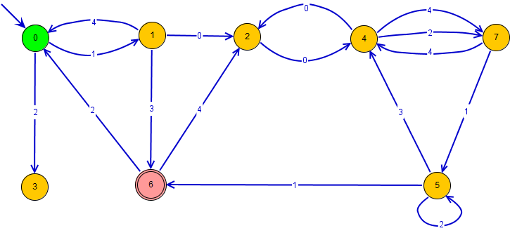
Conceptual Example
Original FSM
E_{c} = {0,1,2} E_{o} = {0}

Slide 5
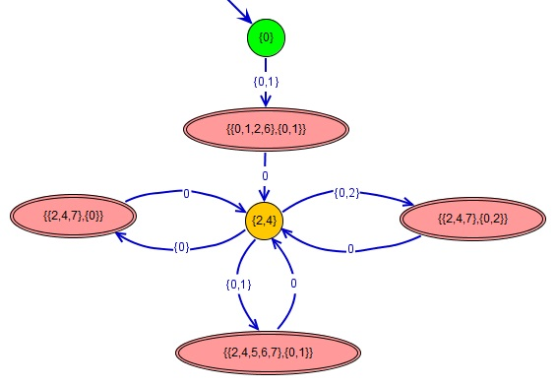
Conceptual Example
Non-Blocking All Inclusive Controlled (NBAIC)

Slide 6
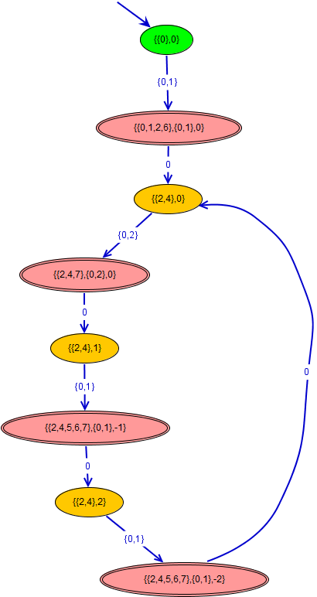
Conceptual Example
Extended Bipartite Transition System (EBTS)

Slide 7
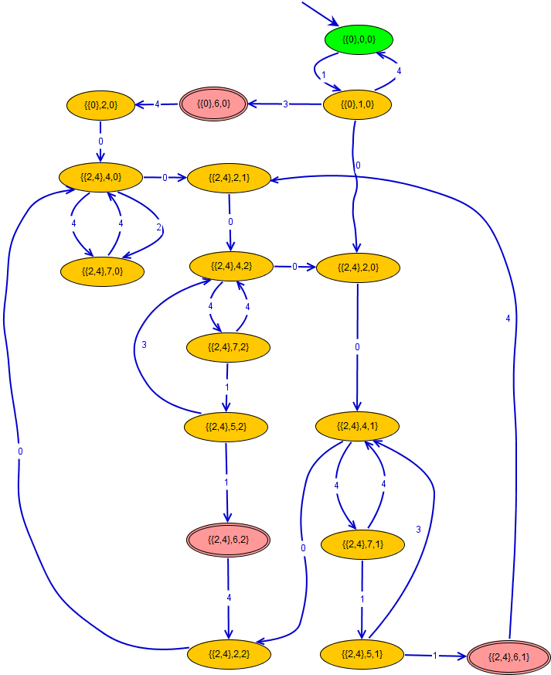
Conceptual Example
Controlled Language Automaton (A_{u} x G)

Slide 8
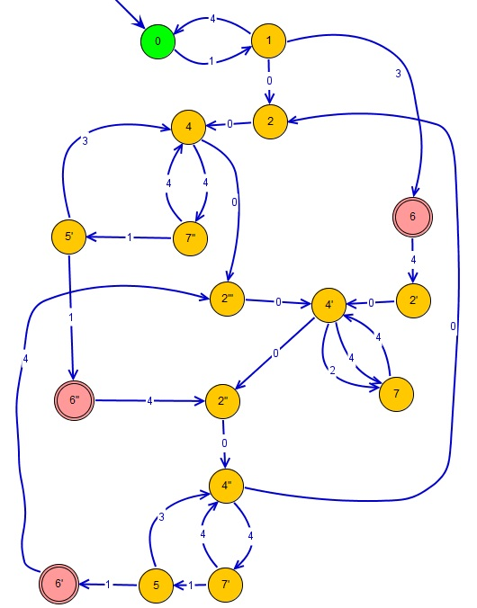
Conceptual Example
Reduced Controlled Language Automaton (A_{u} x G)

Slide 9
Using the Program

Slide 10

If you ever get stuck, the README file is your friend!

Slide 11
Program Modes
BSCOPNBMAX: generate maximally permissive, non-blocking, information-state compliant supervisor
MPO: generate maximally or minimally permissive, non-blocking, information-state compliant sensor activation policy
CONVERT: convert a FSM file between the UMDES .fsm format and the FSM format listed in the README
  NOTE: currently does not retain unused events
INTERACTIVE: choose mode and program options via interactive text prompt displayed during execution

Slide 12
Program Options
Mode [-m] [BSCOPNBMAX | MPO | CONVERT | INTERACTIVE]
MPO Condition [-c] [MIN| MAX]
FSM File [-f] [filename]
Property [-p] [SAFETY | OPACITY | DISAMBIGUATION]
ISP File [-i] [filename]
Verbose [-v]
Write to File [-w]
Help [-h]
NOTE: Arguments for –m, –c , and –p are case insensitive.

Slide 13
FSM File Comparison
UMDES Format
  Not UMDES Format*
8
0 0 2
1 1 c uo
2 3 c uo
1 0 3
3 6 uc uo
4 0 uc uo
0 2 c o
2 0 1
0 4 c o
3 0 0
4 0 3
4 7 uc uo
0 2 c o
2 7 c uo
5 0 3
1 6 c uo
2 5 c uo
3 4 uc uo
6 1 2
4 2 uc uo
2 0 c uo
7 0 2
1 5 c uo
4 4 uc uo
8 5
0 u
1 u
2 u
3 u
4 u
5 u
6 m
7 u
0 c o
1 c u
2 c u
3 u u
4 u u
2 3 1 1
0 2 4 0 3 6
0 4
2 7 0 2 4 7
3 4 2 5 1 6
2 0 4 2
4 4 1 5
*Current only supports Linux line endings!

Slide 14
Using Information State Properties
Safety, Opacity, and State Disambiguation are currently implemented
Instructions for implementing other properties are given in the README—mostly copy/paste unless the property is especially complicated
Property-specific input handled via a separate file

Slide 15
Information State Property Files
Safety: List of unsafe states
Opacity: List of secret states
State Disambiguation: Two lines, each containing a set of states which must remain disjoint from each other

Slide 16
Scalability Testing or
Is this going to take a week to finish?

Slide 17
Stress Tests

Slide 18
Analysis
Adding an event is more likely to cause a dramatic increase in resource consumption than adding a state
Input size is not a strong indicator of resource consumption
  Other factors include graph density, clusters of controllable and unobservable events, and accessibility

Slide 19
Execution Examples!
Notes:
./bin/DES_Supervisor –f ./test/presentation_fsm.txt –v –w

Slide 20
Find a Bug?
Send the input and a description of the error to morrimax@umich.edu and I’ll get to it as soon as possible!

